Slide 1
FAIRmat training materials
Uploading, sharing, and publishing computation data

Slide 2
About this example
In this example we explain the NOMAD upload function, through which users can upload, share, and publish their research data and relevant files.
This example specifically focuses on theory and computation data, to which a NOMAD parser is available.
The availability of a NOMAD parser means that NOMAD is able to recognize the file format, read the files, and structure their contents according to predefined schema.

Slide 3
Learning outcomes
Preparing and uploading files of computation research data.
Modifying generic metadata of a NOMAD upload.
Sharing and collaboration with colleagues.
Exploring the uploaded and processed files in NOMAD.
Publishing datasets and obtaining DOI.
Evaluating the FAIR principles of uploaded entries in NOMAD.

Slide 4
Tasks
Create a NOMAD account.
Prepare the input and output files in .zip file.
Create a NOMAD upload.
Add data files to your NOMAD upload.
Share the upload with a colleague.
Explore your entries.
Understand the data structure.

Slide 5
DFT and GW calculations for silicon

Slide 6
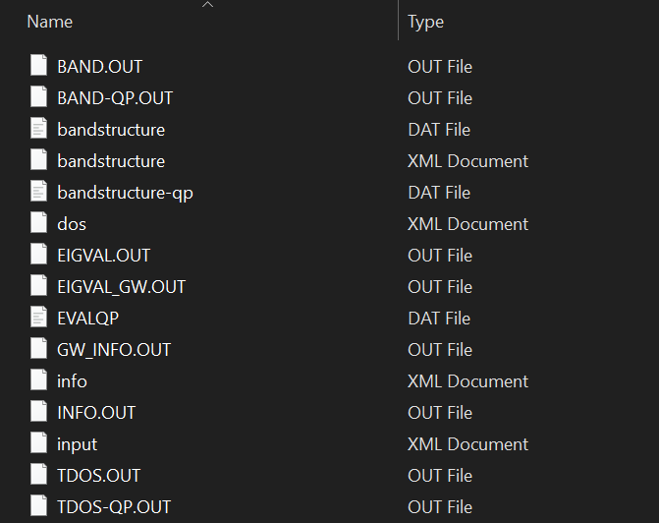
Uploading data to NOMAD
You can upload the files one by one or you can zip them in .zip or .tar.gz formats to upload a larger amount of files at once.

Slide 7
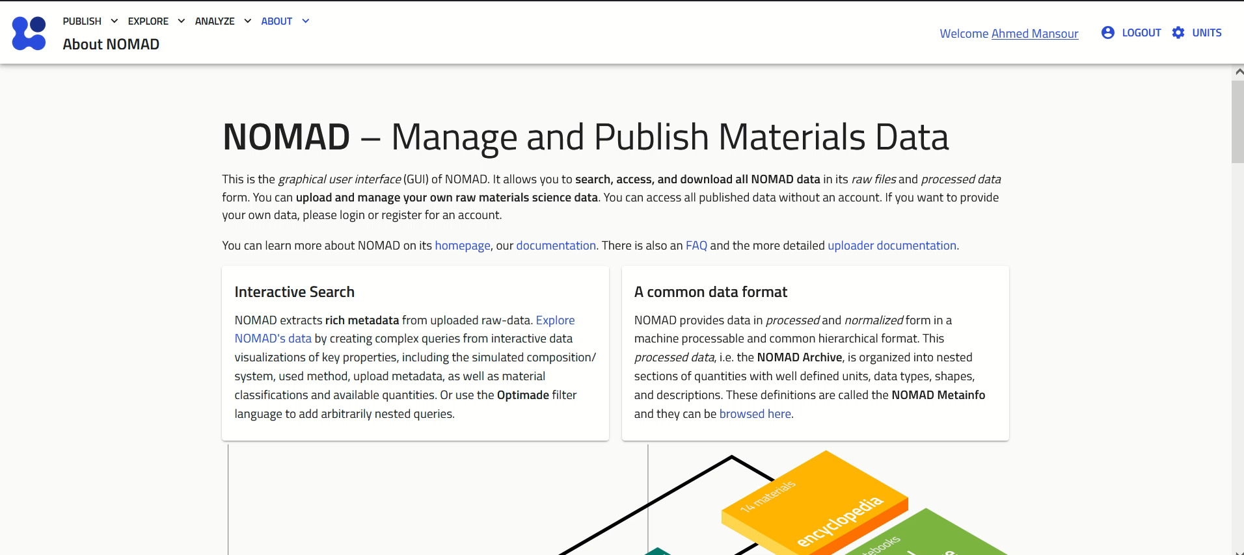
Processing of uploads
Notes:
After the files are uploaded, a processing is triggered. This generally includes an automatic identification of the uploaded files that are supported in NOMAD, and then a corresponding processing to harvest all the relevant (meta)data. The precise details of the processing depend on each use-case

Slide 8
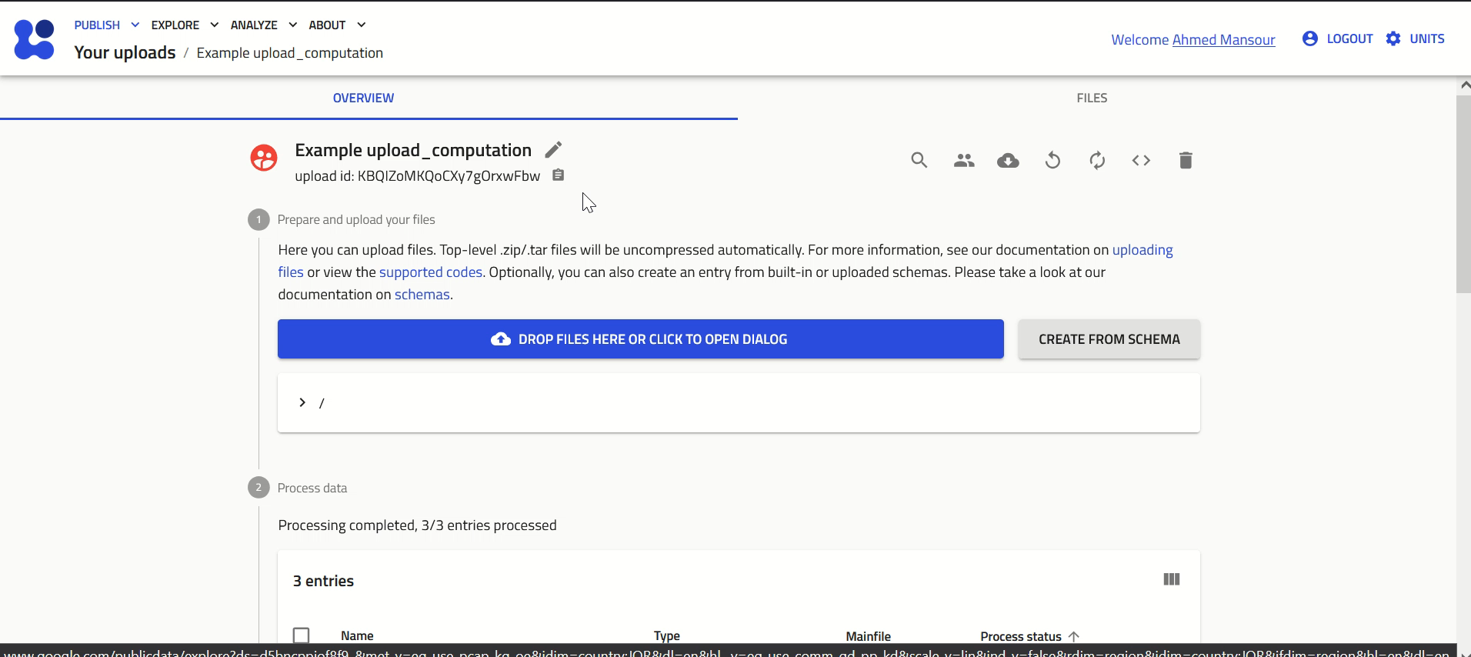
Exploring the entry

